Slide 1
India's Nuclear Policy: From Pokhran I to Pokhran II
Evolution, Challenges, and Global Impacts
Notes:
I’ll be discussing a critical aspect of India’s strategic history—its nuclear policy, tracing the journey from Pokhran I in 1974 to Pokhran II in 1998. This evolution not only shaped India’s security framework but also its standing on the global stage.

Slide 2
Introduction
Nuclear Capability: A Symbol of Technological and Strategic Strength
Since the development of nuclear weapons during World War II, nuclear power has been a cornerstone of geopolitical influence. Post-1945, the nuclear arms race symbolized dominance, with nations like the USA, USSR, China, and others asserting their power through nuclear arsenals. Countries possessing nuclear technology gained a strategic advantage, becoming key players in global decision-making forums.
Technological Advancement:
The mastery of nuclear technology demonstrates a nation's scientific innovation, engineering excellence, and ability to harness complex systems.
For India, achieving this meant not only self-reliance but also global recognition as a technologically advanced country.
Strategic Strength:
Beyond warfare, nuclear weapons function as powerful deterrents, especially in volatile regions.
For India, with nuclear-armed neighbors like China and Pakistan, this capability is crucial for maintaining a balance of power.

Slide 3
Introduction Continued
India’s Post-Independence Vision
Nehru’s Approach:
Prime Minister Jawaharlal Nehru viewed nuclear technology as a tool for peaceful development. Under his leadership, India aimed to utilize nuclear energy for electricity generation, healthcare, and agriculture.
Nehru’s vision was rooted in ethical responsibility, emphasizing that science should serve humanity rather than destruction.
Institutional Foundations:
In 1954, India established the Department of Atomic Energy (DAE) under the leadership of Homi Bhabha, known as the "Father of India’s Nuclear Program."
The focus was initially on building nuclear reactors for energy, including the establishment of the Trombay Atomic Energy Establishment (now Bhabha Atomic Research Centre).
India also became a leader in advocating global nuclear disarmament through platforms like the United Nations.

Slide 4
Introduction Ending
Why the Shift?
External Threats:
The 1962 Sino-Indian war exposed India's vulnerabilities, particularly against a nuclear-armed China. In 1964, China conducted its first nuclear test, altering the regional balance of power.
Pakistan’s rivalry with India further exacerbated security concerns, especially as Pakistan pursued its own nuclear ambitions with external support.
Strategic Realignment:
Recognizing the growing threats, India adopted a more pragmatic approach, emphasizing the need for self-reliance in nuclear capabilities.
The aim was to develop a credible deterrent while maintaining India’s advocacy for peaceful nuclear use and global disarmament.
In summary, India’s initial nuclear journey was shaped by its vision of peaceful development, regional security challenges, and the need for technological independence. These factors eventually led India to take decisive steps in shaping its nuclear policy.
With this foundation laid, India made a bold move in 1974 with its first nuclear test, Pokhran I, which marked a significant shift in its nuclear trajectory. Let’s now delve into the details of this pivotal moment in next slide.

Slide 5
Pokhran I (1974)
India’s First Nuclear Test
Conducted on May 18, 1974, under the leadership of Prime Minister Indira Gandhi, Pokhran I marked India’s entry into the nuclear club.
Code-named Smiling Buddha, the test was conducted in the Thar Desert at the Pokhran Test Range in Rajasthan.
Regional Threats:
China’s successful nuclear test in 1964 was a key driver, as it altered the balance of power in Asia.
The ongoing rivalry with Pakistan also added to India’s security concerns.
Strategic Intent:
While publicly claiming it was a peaceful nuclear explosion (PNE), Pokhran I showcased India’s intent to safeguard its sovereignty and strategic autonomy.
Significance:
Demonstrated India’s ability to indigenously develop nuclear technology.
Enhanced national security amidst growing global and regional tensions.

Slide 6
Pokhran I (1974)
India’s First Nuclear Test
Global Reaction:
Western nations, especially the USA and Canada, condemned the test.
Sanctions were imposed, and the Nuclear Suppliers Group (NSG) was formed to restrict nuclear material and technology access to countries like India.
Pokhran I was a declaration of India’s technological independence and strategic intent. But it also marked the beginning of a challenging era of isolation and sanctions, setting the stage for a policy of self-reliance.

Slide 7
Post-Pokhran I Era
The Era of Isolation and Strategic Ambiguity
Isolation and Sanctions:
Post-Pokhran I, India faced diplomatic and economic isolation, particularly from Western nations.
Sanctions limited India’s access to critical nuclear technology and materials.
India’s Response:
Strengthened indigenous nuclear research and development capabilities.
Focused on peaceful nuclear applications, including energy production, medicine, and agriculture.
Strategic Ambiguity:
India neither confirmed nor denied the weaponization of its nuclear capability.
Advocated for global nuclear disarmament while maintaining its nuclear options open.
The post-Pokhran I era was a period of resilience for India, laying the groundwork for self-reliance and future strategic decisions.”

Slide 8
Pokhran II (1998)
The Assertion of Nuclear Power
Conducted in May 1998 under Prime Minister Atal Bihari Vajpayee, Pokhran II marked India’s declaration as a nuclear weapons state.
Five nuclear tests, including a thermonuclear device, were carried out in secret.
Reasons for Pokhran II:
Strategic Necessity:
Growing nuclear threat from Pakistan, particularly after its successful acquisition of nuclear technology.
China’s strategic dominance in the region.
Political Will:
Vajpayee’s government believed that open declaration of nuclear capability was essential for strategic deterrence and sovereignty.

Slide 9
Pokhran II (1998)
The Assertion of Nuclear Power
Significance:
India transitioned from nuclear ambiguity to open acknowledgment of its nuclear weapons program.
Established a doctrine of credible minimum deterrence, ensuring that India’s nuclear capability would be used only for defense.
Global Reaction:
Immediate backlash with economic sanctions from countries like the USA and Japan.
Opened a new phase of strategic dialogue, particularly with the USA.
Pokhran II was a turning point, cementing India’s status as a nuclear power and redefining its strategic doctrine.

Slide 10
Evolution of India’s Nuclear Doctrine
The Framework of India’s Nuclear Strategy
India’s nuclear doctrine evolved in the late 1990s and early 2000s, driven by the need to formalize its approach after Pokhran II (1998). The doctrine reflects India’s commitment to maintaining strategic stability and reducing the threat of nuclear conflict.
No First Use (NFU):
India declared that it would not use nuclear weapons unless attacked first with nuclear weapons. Reinforces India’s defensive posture, emphasizing deterrence over aggression.
“Nuclear weapons are a means of deterrence, not instruments of war.”
Credible Minimum Deterrence (CMD):
India maintains only the minimum number of nuclear weapons necessary to ensure credible deterrence. Reduces the risks of arms races while ensuring sufficient security against adversaries.
Assured Retaliation:
Any nuclear attack on India will be met with a massive and devastating retaliation. This principle strengthens India’s deterrence by ensuring adversaries understand the consequences of a first strike.

Slide 11
Evolution of India’s Nuclear Doctrine
The Framework of India’s Nuclear Strategy
Goals of the Doctrine
Prevent Regional Escalation:
Serve as a stabilizing factor in South Asia by deterring nuclear conflict with neighbors like Pakistan and China.
Promote Global Disarmament:
India advocates for the eventual elimination of nuclear weapons globally while maintaining its deterrence until disarmament is achieved.
Secure National Sovereignty:
Ensure India’s freedom to make independent strategic and security decisions in the face of external pressures.
Balance Military and Economic Growth:
Avoid excessive nuclear stockpiling to prioritize economic and technological development.

Slide 12
Evolution of India’s Nuclear Doctrine
The Framework of India’s Nuclear Strategy
Significance
Strategic Stability:
India’s doctrine strikes a balance between asserting its nuclear power and maintaining its image as a responsible global player.
Provides reassurance to the international community about India’s non-aggressive intent.
Message to Adversaries:
Sends a clear signal to China and Pakistan about India’s capability and resolve to respond decisively to any aggression.
Global Leadership Role:
Strengthens India’s position as a responsible nuclear state advocating for fair global nuclear regimes, including entry into the Nuclear Suppliers Group (NSG).

Slide 13
Global and Regional Impact
Consequences of Pokhran I & II
Immediate Consequences
Sanctions and Isolation:
After Pokhran II in 1998, India faced widespread condemnation, especially from Western nations like the United States, Canada, and Japan.
International financial institutions like the IMF and World Bank withheld assistance, impacting India’s economic growth.
The sanctions created pressure on India’s economy but also strengthened its resolve to pursue self-reliance in critical sectors.
Diplomatic Repercussions:
India’s relations with several Western nations deteriorated, as they viewed the nuclear tests as a challenge to the global non-proliferation regime.
Despite criticism, India stood firm, emphasizing its commitment to responsible nuclear conduct and global peace.
The tests sparked debates about the fairness of global nuclear rules, which allowed established nuclear powers to maintain their arsenals while restricting others.

Slide 14
Global and Regional Impact
Consequences of Pokhran I & II
Long-Term Impacts
India’s Emphasis on Indigenous Development:
The sanctions highlighted the vulnerability of relying on external resources, driving India to bolster its indigenous technological and scientific capabilities.
Organizations like the Indian Space Research Organization (ISRO) and the Department of Atomic Energy (DAE) played pivotal roles in advancing India’s self-reliance in nuclear technology and delivery systems.
Shift in Global Perception:
The Indo-US Civil Nuclear Agreement in 2008 marked a turning point, acknowledging India as a de facto nuclear weapons state.
This agreement allowed India access to civilian nuclear technology and materials, ending decades of isolation from global nuclear trade.
Regional Nuclear Arms Race:
Pakistan responded to Pokhran II with its own nuclear tests, escalating tensions in South Asia.
The threat of nuclear conflict became a significant concern, particularly during crises like the Kargil War (1999) and the Mumbai attacks (2008).

Slide 15
India’s Current Nuclear Policy
Present-Day Nuclear Strategy
Strategic Modernization
Missile Development:
India has enhanced its missile arsenal with long-range intercontinental ballistic missiles (ICBMs) like Agni-V, capable of striking targets over 5,000 kilometers.
Shorter-range missiles like Agni-I and Prithvi cater to regional deterrence, especially against neighboring threats.
Nuclear Triad:
India has operationalized its nuclear triad, ensuring second-strike capability through:
Land-based missiles.
Air-delivered nuclear bombs via aircraft like the Mirage-2000.
Sea-based deterrence with nuclear-powered submarines, notably INS Arihant.
Focus on Technology:
Development of technologies to enhance survivability, including:
Mobile missile launchers.
Hardened bunkers for storage and command centers.
Sophisticated command-and-control systems to ensure swift decision-making.

Slide 16
India’s Current Nuclear Policy
Present-Day Nuclear Strategy
Global Stance
Advocacy for NSG Membership:
India continues to lobby for inclusion in the Nuclear Suppliers Group, emphasizing its clean record on non-proliferation and responsible nuclear behavior.
Membership would enable access to advanced nuclear materials and technology for peaceful purposes.
Engagement in Disarmament Talks:
India supports global disarmament initiatives like the Comprehensive Test Ban Treaty (CTBT) and Fissile Material Cut-off Treaty (FMCT), though it has not formally signed these due to concerns over discriminatory provisions.
Indo-US Civil Nuclear Agreement:
Highlights India’s growing integration into the global nuclear framework.
Strengthened India’s ability to access civilian nuclear technology and foster international partnerships.
Partnerships with Nuclear Powers:
Expanding bilateral agreements for peaceful nuclear energy use with nations like Russia, France, and the USA.

Slide 17
India’s Current Nuclear Policy
Present-Day Nuclear Strategy
Challenges
Regional Instability:
Continued tensions with Pakistan over cross-border terrorism and disputed regions like Kashmir.
Concerns over Pakistan’s tactical nuclear weapons and their potential for battlefield use.
China’s Rising Influence:
China’s advancements in hypersonic missiles and space-based weaponry have prompted India to upgrade its defense systems.
Border disputes, like those in the Ladakh region, add to the strategic complexity.
Balancing Deterrence and Diplomacy:
Maintaining a credible deterrent while advocating for global non-proliferation and disarmament.
Avoiding an arms race while ensuring security in an evolving geopolitical environment.
Technological Challenges:
Need for continued investment in modernization and cybersecurity to protect nuclear assets from emerging threats like cyberattacks.

Slide 18
Conclusion
The Legacy of Pokhran
Summary:
Pokhran I and II are milestones in India’s journey toward strategic independence and global recognition.
India’s nuclear policy reflects a balance between security needs and ethical responsibility.
India’s nuclear journey underscores its commitment to challenging the inequities of the global non-proliferation regime while promoting peaceful nuclear technology use.
The Pokhran tests established India’s position as a credible nuclear power, effectively deterring regional adversaries and reinforcing its sovereignty.
“India’s nuclear journey is a story of resilience, innovation, and responsibility—an assertion of sovereignty and a commitment to global peace.”

Slide 19
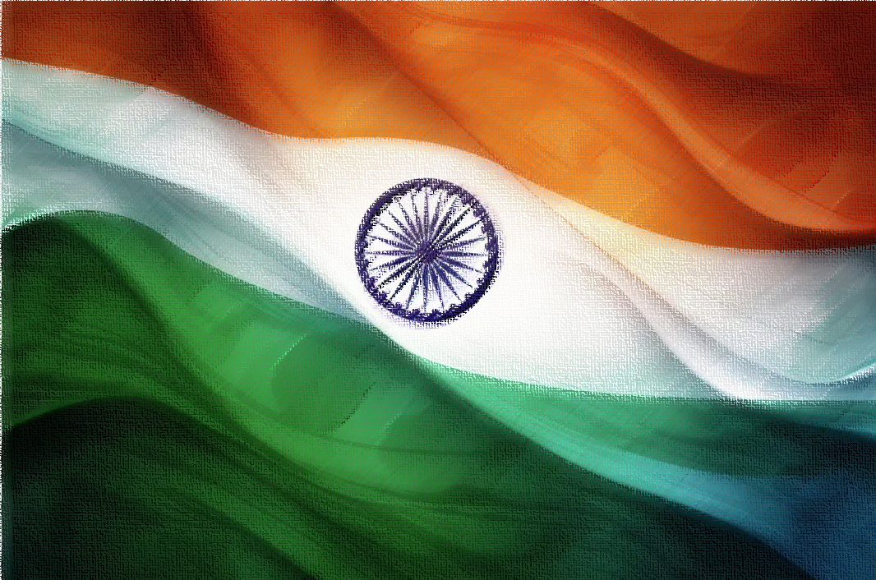
Thank You
Jai Hind Jai Bharat
By Harsh Verma

